Slide 1
Concept-based Short Text Classification and Ranking
Date:2015/05/21
Author:Fang Wang, Zhongyuan Wang, Zhoujun Li, Ji-Rong Wen
Source:CIKM '14
Advisor:Jia-ling Koh
Spearker:LIN,CI-JIE

Slide 2
Outline
Introduction
Method
Experiment
Conclusion

Slide 3
Outline
Introduction
Method
Experiment
Conclusion

Slide 4
Introduction
Most existing approaches for text classification represent texts as vectors of words, namely “Bag-of-Words”
This text representation results in a very high dimensionality of feature space and frequently suffers from surface mismatching

Slide 5
Introduction
Goal:
using “Bag-of-Concepts” in short text representation, aiming to avoid the surface mismatching and handle the synonym and polysemy problem
Jeep、Honda
Car
Bag of words
Bag of concepts

Slide 6
Introduction
Goal:
Short text classification is based on “Bag-of-Concepts”
Classify
Beyonce named People’s most beautiful woman
Music
Lady Gaga Responds to Concert Band

Slide 7
Outline
Introduction
Method
Experiment
Conclusion

Slide 8
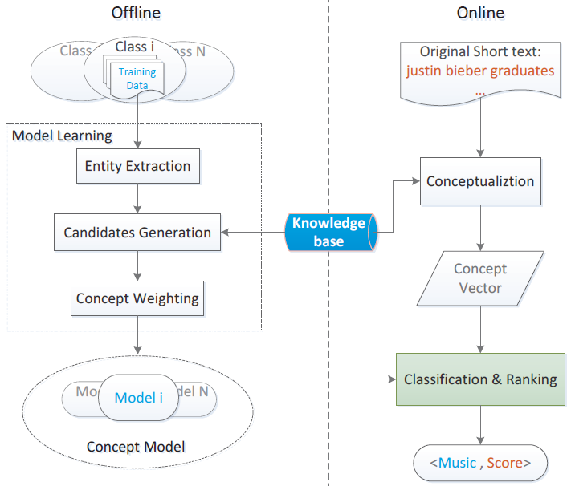
Framework

Slide 9
Framework

Slide 10
Entity Recognition
Documents are first split to sentences
Use all instances in Probase as the matching dictionary for detecting the entities from each sentence
Stemming is performed to assist in the matching process
Extracted entities are merged together and weighted by idf based on different classes
Beyonce named People’s most beautiful woman
Beyonce named People’s most beautiful woman
Set={beyonce}, Idf(Beyonce)=2

Slide 11
Candidates Generation
Given entity $e_{j}$, we select its top $N_{t}$concepts ranked by the its typical concept P(c|e)
Merge all the typical concepts as the primary candidate set
Computing the idf value for each concept in the class level
Removing stop concepts , which tend to be too general to represent a class
c1,c2,...c20
Merge
c1,c2,...
cn
Idf(c1,c3,...
cn)
c1,c2,...
cn
Computing idf
Removing stop concepts
$$e_{j}$$
$${\text{Ｕ}}_{e_{j}}$$

Slide 12
Concept Weighting
The top $N_{t}$ concepts still contain noise
Weight the candidates to measure their representative strengths for each class
Given entity “python” in class Technique, mapping method will result in its top $N_{t}$ concepts list including animal

Slide 13
Typicality
Use a probabilistic way to measure the Is-A relations
given an instance e, which has Is-A relationship with concept c
penguin is-a bird
Take Probase as a Knowledge database in this paper
terms in Probase are connected by a variety of relationships
<concept>\t<entity>\t<frequency>\t<popularity>\t<ConceptFrequency>\t<ConceptSize>\t<ConceptVagueness>\t<Zipf_Slope>\t<Zipf_Pearson_Coefficient>\t<EntityFrequency>\t<EntitySize>

Slide 14
Typicality
n(e, c) denotes the co-occur frequency of e and c
n(e) is the frequency of e
penguin is-a bird
<concept>\t<entity>\t<frequency>\t<EntityFrequency>
<bird>\t<penguin>\t<50>\t<100>
$$P\left(bird | penguin\right)=\frac{n(penguin,bird)}{n(penguin)}$$

Slide 15
Framework

Slide 16
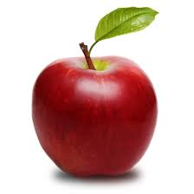
Short Text Conceptualization
Short Text Conceptualization aims to abstract a set of most representative concepts that can best describe the short text
apple ipad
?

Slide 17
Short Text Conceptualization
detect all possible entities and then remove those contained by others
given the short text “windows phone app,” the recognized entity set will be {“windows phone,” “phone app”}, while “windows,” “phone,” and “app” are removed
the entity list $E_{{st}_{i}}$= {$e_{j}$ , j = 1, 2, ..., M} for a short text ${st}_{i}$
Sense Detection
detect different senses for each entity in $E_{{st}_{i}}$, so as to determine whether the entity is ambiguous
Disambiguation
disambiguate vague entity by leveraging its unambiguous context entities

Slide 18
Sense Detection
Denote $C_{e_{j}}$ = {$c_{k}$, k = 1, 2, ..., $N_{t}$} is $e_{j}′$s typical concept list
Denote ${CCl}_{e_{j}}$ = {${ccl}_{m}$ , m = 1, 2, ...} is $e_{j}′$s concept cluster set
$$c_{k}$$
歌手
$${ccl}_{m}$$
演藝
$$e_{j}$$
Beyonce
作詞人
模特兒
設計
時裝設計師

Slide 19
Sense Detection
$$c_{k}$$
Entropy越高${，e}_{j}的意義越模糊$
Entropy越低${，e}_{j}的意義越明確$
歌手
$${ccl}_{m}$$
0.3
演藝
$$e_{j}$$
0.3
Beyonce
作詞人
0.3
$$P\left(演藝 | Beyonce\right)=0.3+0.3+0.3$$
模特兒
0.1
設計
時裝設計師

Slide 20
Disambiguation
Denote the vague entity as $e_{i}^{v}$, and unambiguous entity $e_{j}^{u}$

Slide 21
Disambiguation
Denote the vague entity as $e_{i}^{v}$, and unambiguous entity $e_{j}^{u}$
$$P^{′}\left(演藝 | Beyonce\right)=P\left(演藝 | Beyonce\right)∗P\left(音樂學 | music\right)∗CS(演藝,音樂學)$$
+$P\left(演藝 | Beyonce\right)∗P\left(音樂學 | \text{songs}\right)∗CS\left(演藝,音樂學\right)$
= 0.2*0.9*0.9 + 0.2*0.9*0.9 = 0.324
Beyonce music and songs
$$P^{′}\left(設計 | Beyonce\right)=P\left(設計 | Beyonce\right)∗P\left(音樂學 | music\right)∗CS(設計,音樂學)$$
+$P\left(設計 | Beyonce\right)∗P\left(音樂學 | \text{songs}\right)∗CS\left(設計,音樂學\right)$
= 0.2*0.9*0.1 + 0.2*0.9*0.1 = 0.036
設計
演藝
音樂學
$P(演藝|Beyonce)$=0.5
$P(音樂學|\text{music})$=1
$P(設計|Beyonce)$=0.5
$P(音樂學|\text{songs})$=1
$${ccl}_{m}=\{設計,演藝\}$$
$${ccl}_{n}=\{音樂學\}$$

Slide 22
Disambiguation
Denote the vague entity as $e_{i}^{v}$, and unambiguous entity $e_{j}^{u}$
$P(演藝|Beyonce)$=0.5 ${ P}^{′}\left(演藝 | Beyonce\right)=0.324$
$P(設計|Beyonce)$=0.5 ${ P}^{′}\left(設計 | Beyonce\right)=$ 0.036
$$P^{′}\left(演藝 | Beyonce\right)=P\left(演藝 | Beyonce\right)∗P\left(音樂學 | music\right)∗CS(演藝,音樂學)$$
+$P\left(演藝 | Beyonce\right)∗P\left(音樂學 | \text{songs}\right)∗CS\left(演藝,音樂學\right)$
= 0.2*0.9*0.9 + 0.2*0.9*0.9 = 0.324
Beyonce music and songs
$$P^{′}\left(設計 | Beyonce\right)=P\left(設計 | Beyonce\right)∗P\left(音樂學 | music\right)∗CS(設計,音樂學)$$
+$P\left(設計 | Beyonce\right)∗P\left(音樂學 | \text{songs}\right)∗CS\left(設計,音樂學\right)$
= 0.2*0.9*0.1 + 0.2*0.9*0.1 = 0.036
設計
演藝
音樂學
$P(演藝|Beyonce)$=0.5
$P(音樂學|\text{music})$=1
$P(設計|Beyonce)$=0.5
$P(音樂學|\text{songs})$=1
$${ccl}_{m}=\{設計,演藝\}$$
$${ccl}_{n}=\{音樂學\}$$

Slide 23
Disambiguation
CS(${ccl}_{m},{ccl}_{n}$) denotes the concept cluster similarity
民族歌手
民族音樂學
民族$音樂學$
系統音樂學
歷史音樂學
民族歌手
鄉村歌手
$$e_{i}$$
$$e_{i+1}$$
...
$$e_{j}$$
$$e_{+1}$$
...
$$e_{k}$$
$$e_{l}$$
$$音樂學$$
$$演藝$$

Slide 24
Framework

Slide 25
Classification
classify the short ${text st}_{i}$ to the class ${CL}_{l}$ that is most similar with ${st}_{i}$
${st}_{i}$’s concept expression $C_{{st}_{i}}$= {$C_{j}$ , j = 1, 2,...,M}
$$C_{k}$$
Beyonce music and songs
C1
C2
C3
C2
C3
C4
演藝
音樂學
演藝
$${CM}_{l}$$
$C_{{st}_{i}}$= {演藝、音樂學}

Slide 26
Ranking
Ranking by Similarity
each short text ${st}_{i}$ assigned to ${CL}_{l}$ has a similarity score, we can rank them directly by their scores
Ranking with Diversity
diversify the short texts by subtopic Proportionality(PM-2) [12]

Slide 27
Outline
Introduction
Method
Experiment
Conclusion

Slide 28
Experiment
evaluate the performance of BocSTC(Bag-of-Concepts - Short Text Classification) on the real application - Channel-based query recommendation
Query recommendation for Channel Living

Slide 29
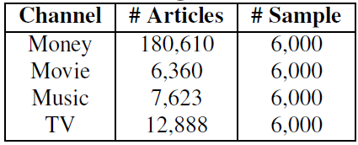
Experiment
Four commonly used channels are selected as targeted channels
Money, Movie, Music and TV
Training dataset
randomly select 6,000 documents for each channel
The titles are used as training data for BocSTC

Slide 30
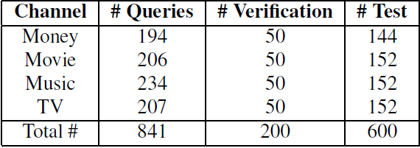
Experiment
Test dataset
841 labeled queries, from which, 200 are selected randomly for verification and 600 for testing

Slide 31
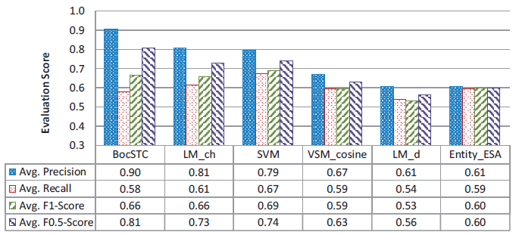
Experiment
Performance on query classification

Slide 32
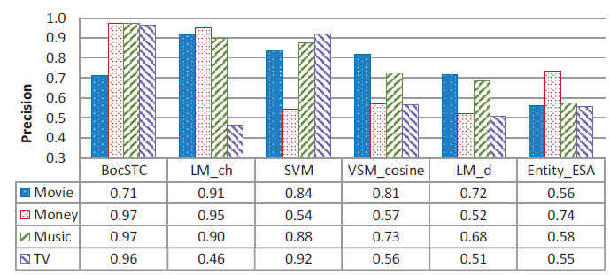
Experiment
Precision performance on each channel

Slide 33
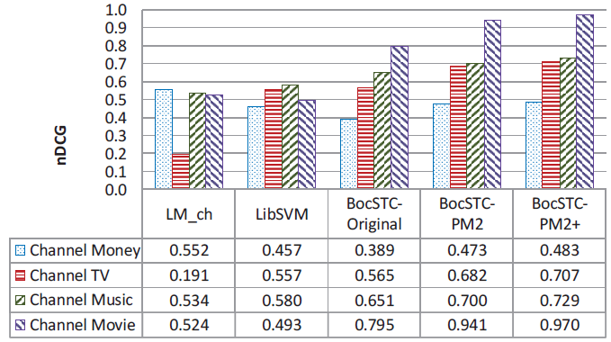
Experiment
manually annotate top 20 queries with the guidelines
Unrelated、Related but Uninteresting、Related and Interesting
Diversity performance on each channel

Slide 34
Outline
Introduction
Method
Experiment
Conclusion

Slide 35
Conclusion
propose a novel framework for short text classification and ranking applications
It measures the semantic similarities between short texts from the angle of concepts, so as to avoid surface mismatch

Slide 36
Thanks for listening.

